Slide 1
Simple inverter design
Prepared by
Md hasemi rafsan jani shohan
Id 191-33-849
L3t2 pc b

Slide 2
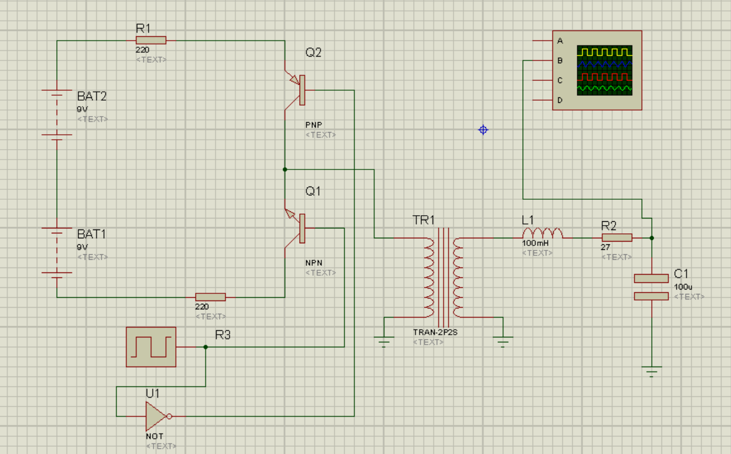
GENERAL CIRCUIT OF SIMPLE INVERTER

Slide 3
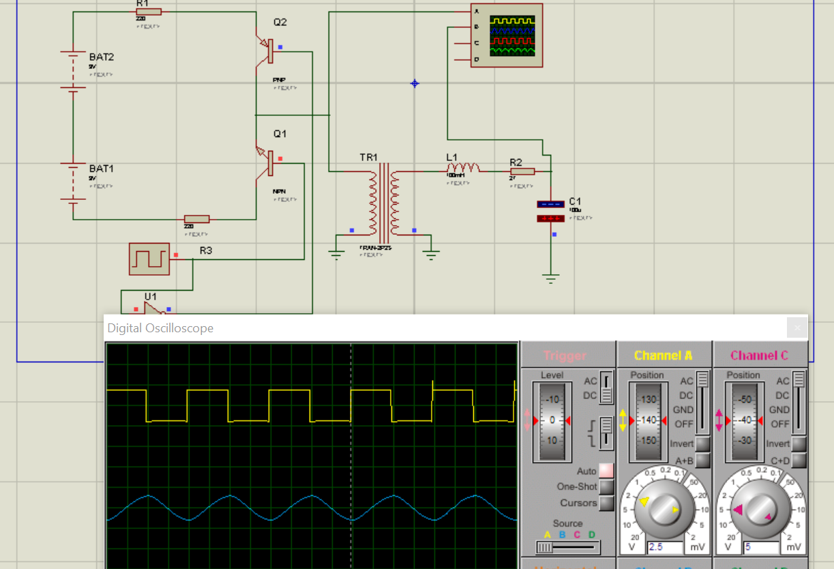
INVERTER OUTPUT SQUARE WAVE FROM TO SIN WAVE FORM

Slide 4
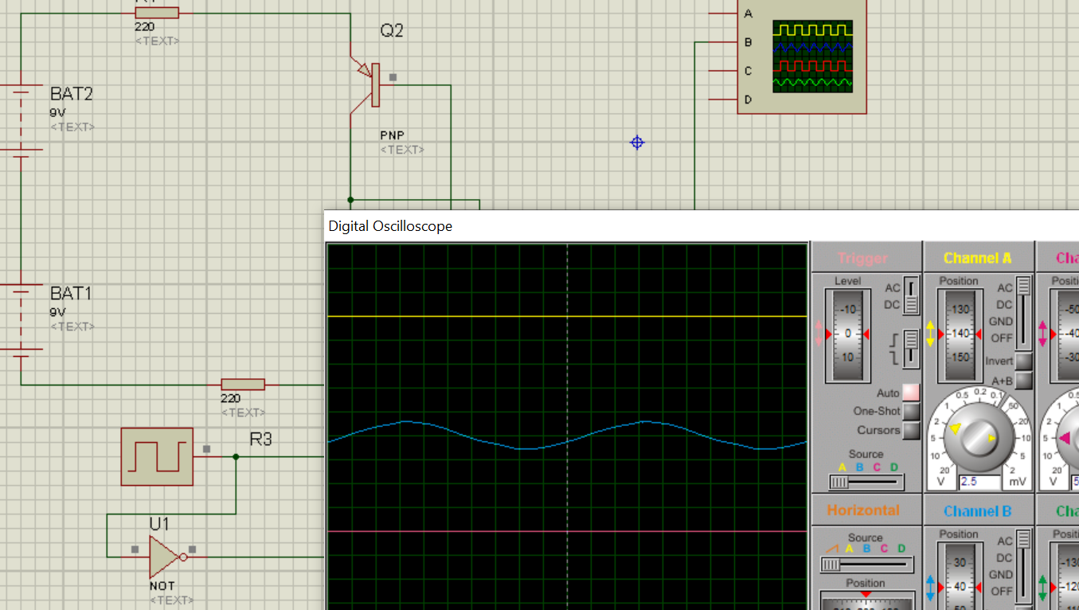
INVERTER OUTPUT SQUARE WAVE FROM TO SIN WAVE FORM

Slide 5
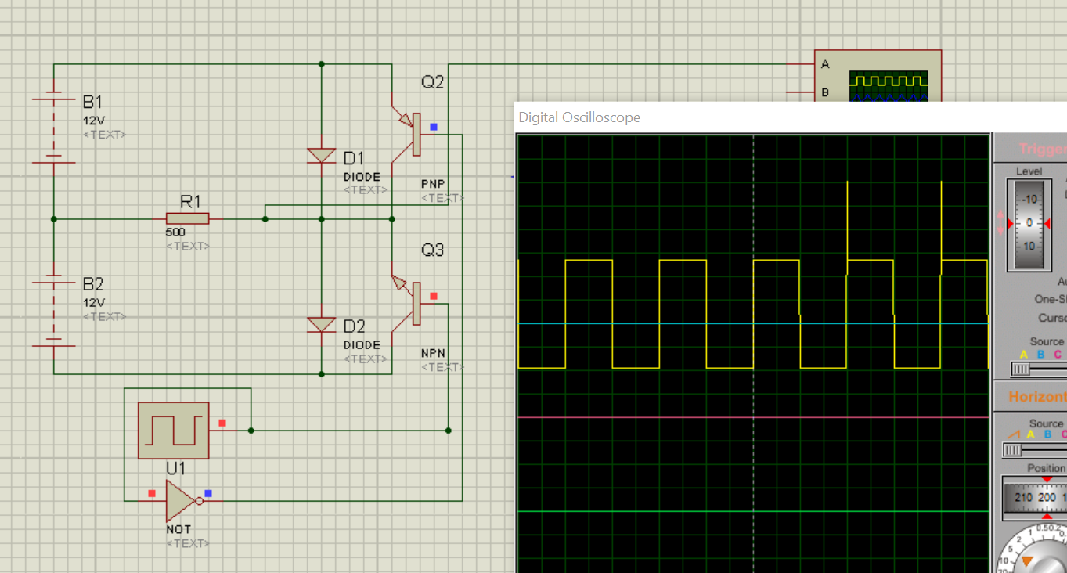
OUTPUT SQUARE WAVE FORM ACROSS THE LOAD RESISTOR

Slide 7
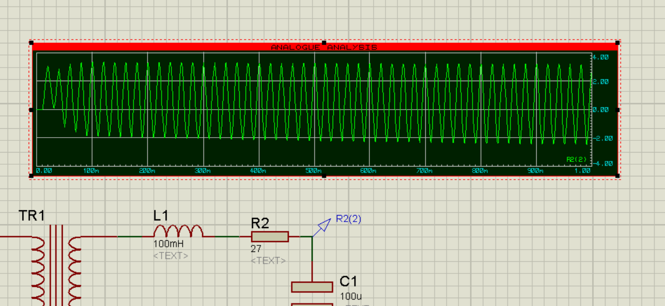
AFTER USING RLC FILTER SQURE WAVE C0NVERTED TO SIN WAVE

Slide 8
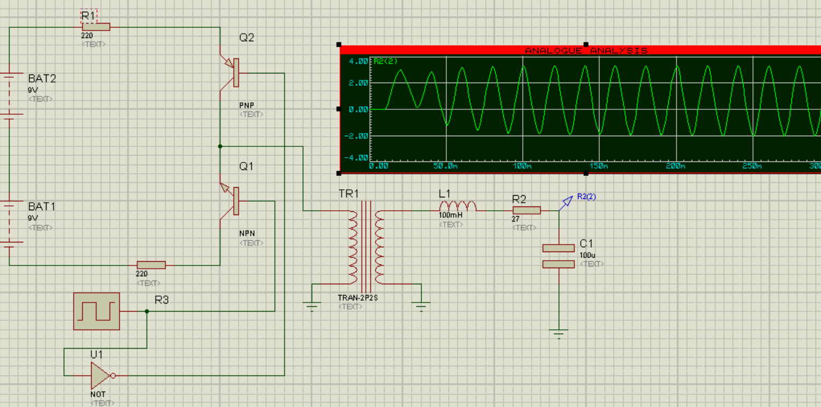
AFTER FILTERING ACROSS C1 WE GET PURE SIN WAVE

Slide 9
REQUIRTED COMPONENT AND THERE VALUE
BATTERY1 9V
BATTERY 2 9V
R1 220 OHM
R2 220 OHM
PNP &NPN TRANSISTOR
SQUARE WAVE GENERATOR 50 HZ
U1 NOT GATE
TR1 TRANSFORMER
L1 INDUCTOR 100mH
R2 27 OHM
C1 CAPACITOR 100uF

Slide 10
THANK YOU MAM
FOR TEACHING EVERY INPORTANT TOPIC ON INVERTER

